Slide 1
EXPLORATORY DATA ANALYSIS CAPSTONE PROJECT-01 EDA ON PLAY-STORE
Notes:
Hello and welcome, my name is Nikhil Roeewal and today I will be presenting to you the results of the Data Analytics task.

Slide 2
1
Project Recap
4
Process
Agenda
2
Problem
5
Insights
3
Analytics Team
Notes:
Today's agenda will be as follows:
1. We will recap the overall project to give a high level understanding of the business problem we're tackling and the specific requirements.
2. We will dive into the specific problem that we, the Data Analytics team, have been focusing on and will give some background as to why this is such a big problem.
3. After introducing the problem, I will go over the team responsible from our side in tackling this task.
4. I will then go over the high-level process that we followed to complete this task, so that you have complete clarity in how we tackle these kinds of tasks.
5. Finally, I will go over the all important results and I will present them as a series of insights and visualizations from our analysis.
To wrap up, I will summarize and open for any questions

Slide 3

Project Recap
Play store Analysis
Notes:
let me recap this Project.
Mobile apps are everywhere. They are easy to create and can be lucrative, because of these two factors, more and more apps are being developed. In this notebook, we will do a comprehensive analysis of the Android app market by comparing over ten thousand apps in Google play store across different categories.
The Play Store apps data has enormous potential to drive app-making businesses to success. Actionable insights can be drawn for developers to work on and capture the Android market.
At last we have conducted an analysis of play store data to find insights of content.

Slide 4

Problem
Notes:
Focusing on the last point that I mentioned there, that we have to generate insights of our data.
Clearly with such grand scale of data with such vast amounts of Rows and Columns comes with a lot challenges that makes this project more interesting.
To give a background on how much data we are working, alma better provided us with two datasets.
First one is Playstore.csv -> contains all the details of the applications of Google Play. There are 13 features that describe a given app.
and the second one is User_reviews.csv -> contains 100 reviews for each app, most helpful first. The text in each review has been pre-processed and attributed with three new features
Sentiments (Positive, Negative, Neutral)
Sentiment Polarity
Sentiment Subjectivity
In this day and age, content is king. Just look at some of the biggest platforms in the world, for example YouTube, Facebook and Netflix... they are all content businesses somehow contents also plays an impact on which app we will use or dwonload from playstore...
It's not just all about harvesting as much data as possible... The real value is in understanding and crunching this data to gain a deeper understanding of your audience and to therefore provide a more personalized and enjoyable experience.
And this is where out data analytics expertise comes in, with the insights that we've uncovered from this task, we can show you exactly how to take analytics to production at scale.

Slide 5
Analytics Team Mates
Sumanta
Banerjee
Nikhil Roeewal
Zayeem Ahmed
Ajit Padole
Manoj Sridala
Notes:
Talking about Team Mates, we had a team of 5 people primarily focusing on this task.
Zayeem Ahmed is ourTechnical Architect and his expertise really helped to guide the team to produce high quality analysis.
Sumanta Banerjee , a data expert has worked with the different type of data that available on kaggle and was heavily involved in the data engineering side of this project.
Ajit Padole and Manoj Sridala work on the data cleaning part of this project.
And finally myself, Nikhil Roeewal, who was solely responsible for taking leadership guidance and delivering high quality insights from the raw datasets and turning these into business decisions.

Slide 6





Process
01
Data Understanding
02
Data Cleaning
03
Correcting Data Type
04
EDA
05
Missing/Null Value
Notes:
So, how did we tackle this problem?
Well, we approached it in 5 steps:
1. Data understanding - the key to success on any data project is to understand the data in detail. So we took the time to understand the data model and domain of your dataset.
2 . Data Cleaning-Data cleaning is one of the most essential subtask any data science project. Although it can be a very tedious process, it's worth should never be undermined.
By looking at a random sample of the dataset rows (from the above task), we observe that some entries in the columns like Installs,Price and Size have a few special characters (+ , $ ,M , k) due to the way the numbers have been represented. This prevents the columns from being purely numeric, making it difficult to use them in subsequent future mathematical calculations. Ideally, as their names suggest, we would want these columns to contain only digits from [0-9]
3. Correcting Data Type - From the previous task we noticed that Installs and Price were categorized as object data type (and not int or float) as we would like. This is because these two columns originally had mixed input types: digits and special characters. To know more about Pandas data types, read this.
The four features that we will be working with most frequently henceforth are Installs, Size, Rating and Price. While Size and Rating are both float (i.e. purely numerical data types), we still need to work on Installs and Price to make them numeric.
4.EDA- After extracting the raw data, we needed to process and model this data into a dataset that can precisely answer the business questions and produce analytics. With our new dataset, we used our analytical expertise to uncover insights from this dataset and to produce visualizations to describe the insights.
5 and the last step is lets eliminate the null values.

Slide 7
Insights/Story
Notes:
let's make our exploratory data analysis more amazing by assuming it is storytelling, just like any other story, there will be one main character "Installs" around which our whole story will roam and we will discover who is his friends, foes, and the ones who just don't care about him.
As we can see there is one more character who is just a duplicate of "Category" that is "genres", so our main task is to remove it from the story, so that the audience will not get confused between the "Category" and "genres", along with it we will remove some other characters as well, as you know we can represent only important scenarios that it related to our main character.
let's move to the visualization part, we will transform our character to a state where it is really easy for our audience to get an idea about him.

Slide 8
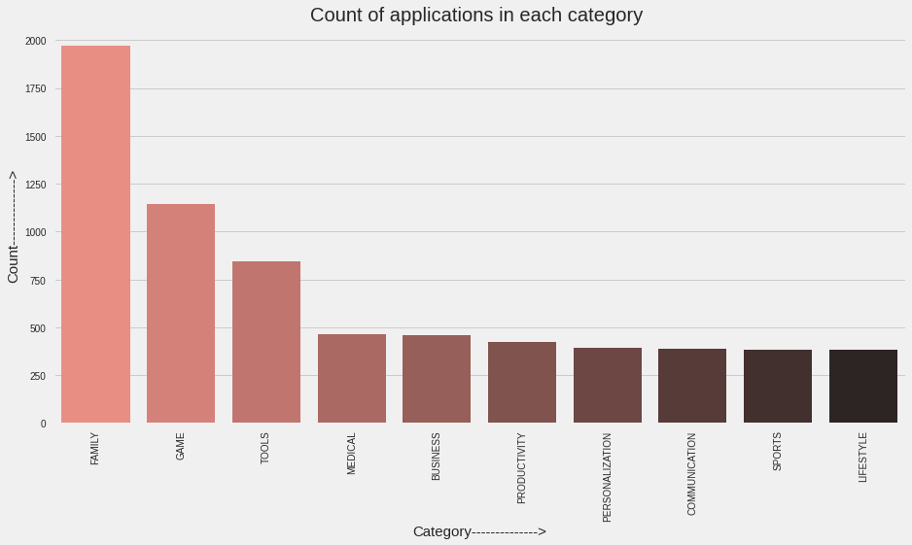
Observation - 1
Notes:
Now we'll get into the fun part. We will try different visualization techniques to understand the life of our main character "Installs" and other characters.
so right now we are focusing on top 10 category according to the number of apps.
Now we know that the 'Family' and 'Game' category rules the play store market, followed by Tools, Medical, and Business. Okay Cool .....
Data Analytics will understand our daily requirements and fill the market with similar apps.

Slide 9
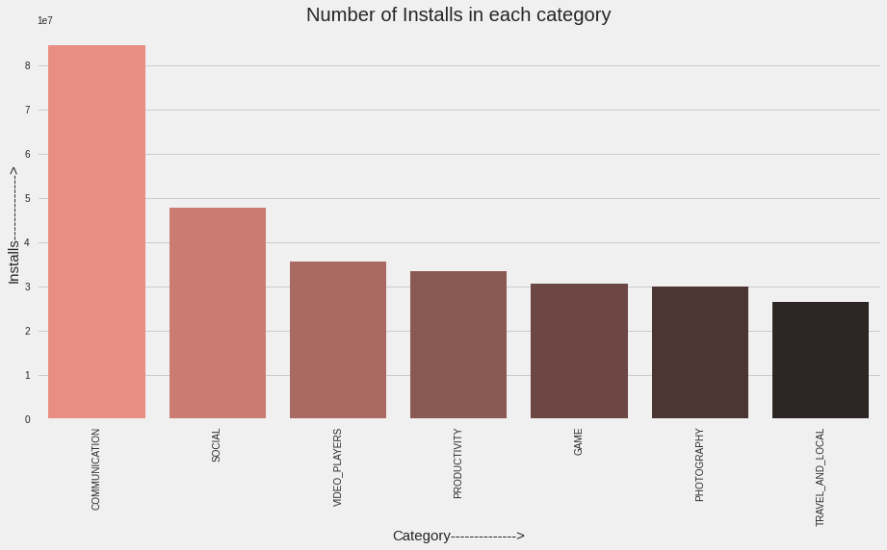
Observation - 1.1
Notes:
So let's compare our main character "installs" with "category" which is one of the other characters.
we used bar plot here
Woww... Family betrayed our 'Installs‘. As we have seen so far, the list of Top 7 Characteristics of 'Category' (acc. to the number of apps developed) and Top 7 Characteristics (acc. to number of Installs) differ a lot. We can feel this story. As data analyst, we can use this information to decide our future insights.

Slide 10
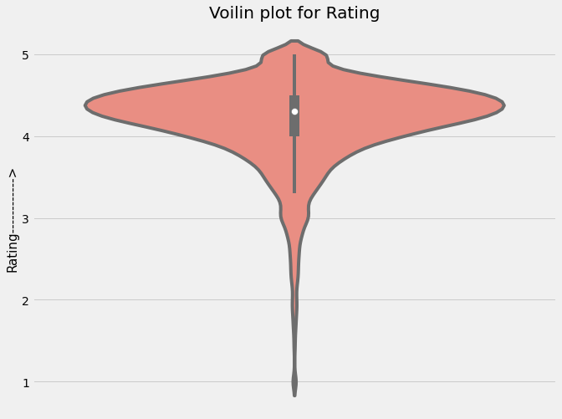
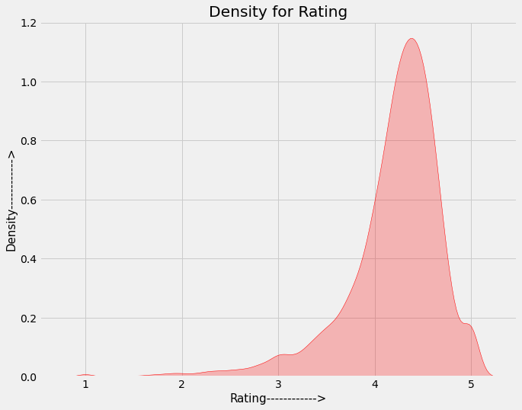
Observation - 2
Notes:
let's see some other character "ratings" for which we are using violin plot and density plot that makes our story content more interesting in visual aspects.
From our research, we found that the average volume of ratings across all app categories is between 4-4.5.
The histogram plot is skewed to the left indicating that the majority of the apps are highly rated with only a few exceptions in the low-rated apps.

Slide 11
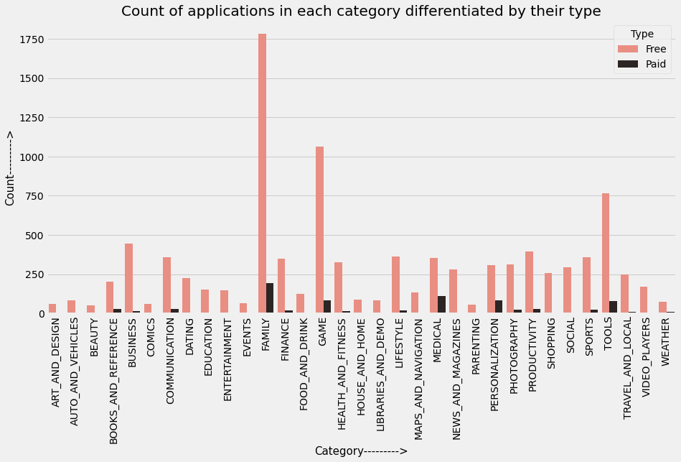
Observation - 3
Notes:
our hero 'Installs' moves forward on his journey. He has two paths to go -> 'Free' and 'Paid'. Let's see what happens now and what moves our hero takes.
It looks like certain app categories have more free apps available for download than others. In our story, the majority of apps in the Family, Food & Drink, and Tools, as well as Social categories were free to install.
At the same time Family, Sports, Tools, and Medical categories had the biggest number of paid apps available for download.

Slide 12
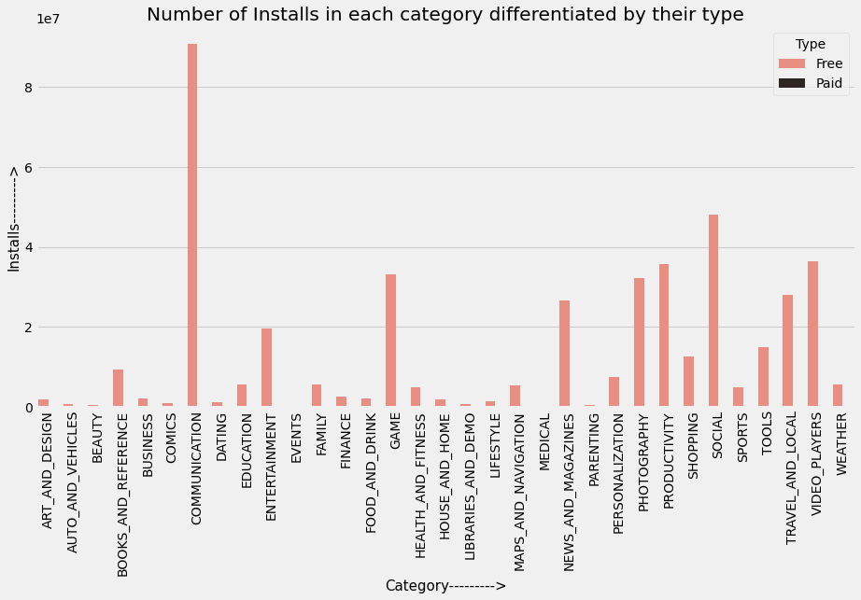
Observation – 3.1
Notes:
let's see how our hero "Installs" affects the results of the above chart.
It can be concluded that the number of free applications installed by the user is high when compared with the paid ones.
Yea... I know ... It was a boring part... It turns out that in our storyline we have two paths... 'Free' and "paid" which is approx negligible so let's ignore it and continue our story on a free path.

Slide 13
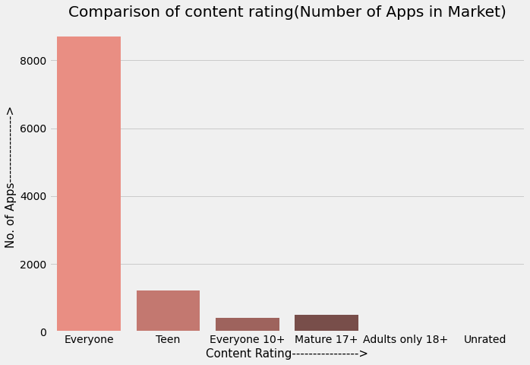
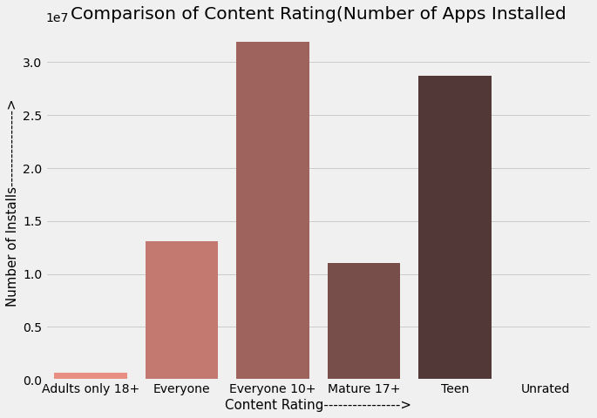
Observation - 4
Notes:
Have you ever wondered if the Content Rating of the App plays an impact on its number of installations!!! Let's feed our curiosity.
Okay !! It seems like 'Everyone' is the only choice for us to prefer when we are considering count.
let's see how its behavior got changed with our hero "installs".
Number of 'Teen' Apps are few as compared to 'Everyone' but when we check its 'Number of Installations', it seems like a good second best choice. Few apps but Considerable Installations
Ahaaa !! Our hero 'Install' just got his first good partner XD. Let's interrogate it.
wow !!! Isn't that like a suspensive story twist By a little tweak, we have got a completely different story? 'Everyone' is an easy option but 'Teen' and '10+' are the most rewarding.

Slide 14
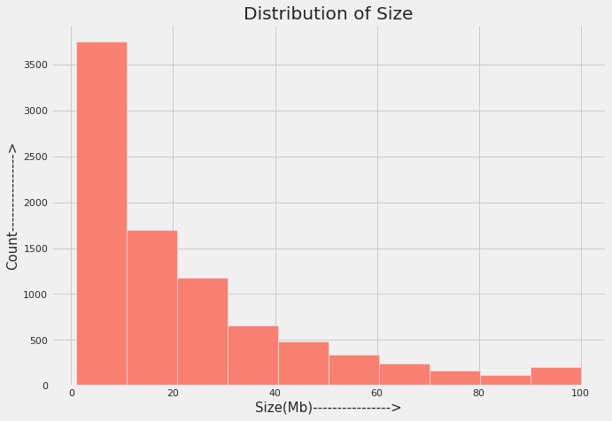
Observation - 5
Notes:
let's introduce a new character "Size(Mb)" in the story, first, we will understand its role in our story then we will see his relationship with our hero "Installs".
From the above histogram, it can be concluded that maximum number of applications present in the dataset are of small size.
lets see its relation with our hero.

Slide 15
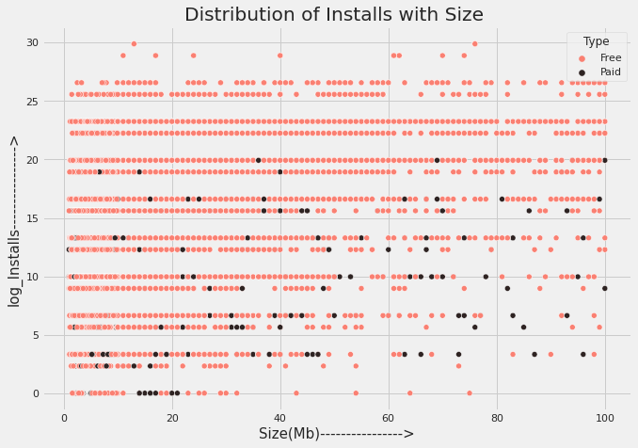
Observation – 5.1
Notes:
It is clear from the above mentioned plot that size may impact the number of installations.
Bulky applications are less installed by the user.
our hero failed to impress big size Apps, on the other hand he works absolutely amazing with small size Apps.

Slide 16
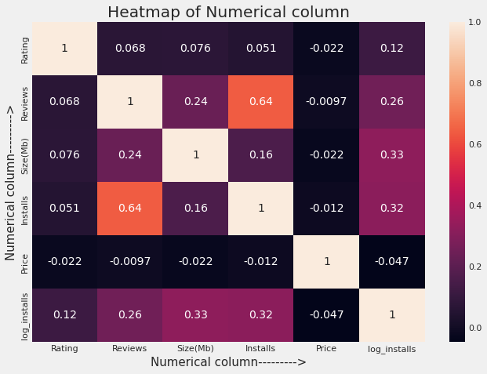
Correlation check
Notes:
Till now, our story has been building slowly. Now let's increase its pace and see the relationship of our hero 'Installs' with other characters......
isn't surprising our main character is so alone in the story, no neighbor cares about him. They all are completely uncorrelated except for Reviews. Reviews seem to have some effect on the number of Installs, BUT WAIT We can be wrong here. It can be a minor data leakage condition. With more installs, more reviews will come to our story/dataset. So they are more codependent.

Slide 17
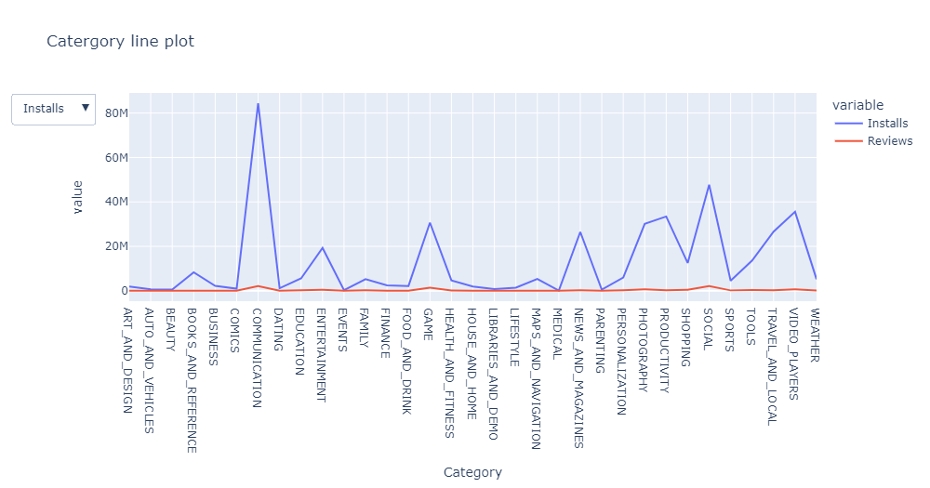
Check - 1
Notes:
lets justify our corelation check story part, which increase our story pace and see the relationship between "installs" and "Reviews"

Slide 18
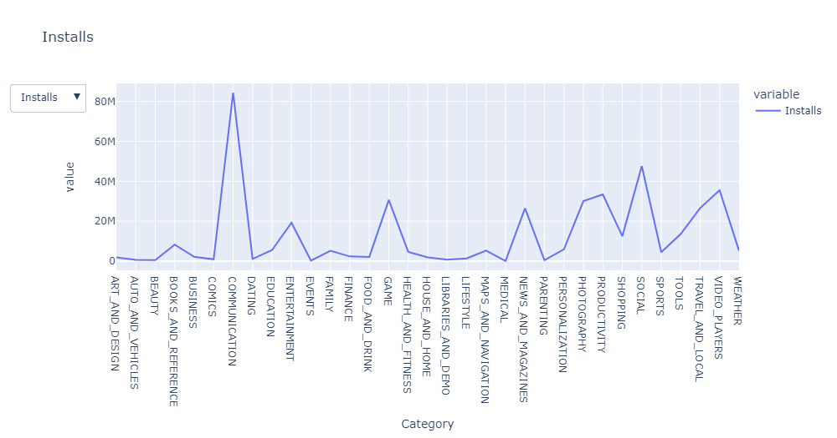
Check - 2
Notes:
As our hero "Installs" vs "Reviews" have a correlation value of 0.64, shows perfect and strong correlationfrom above line chart as both "installs" and "Reviews" follow the same pattern approximately.

Slide 19
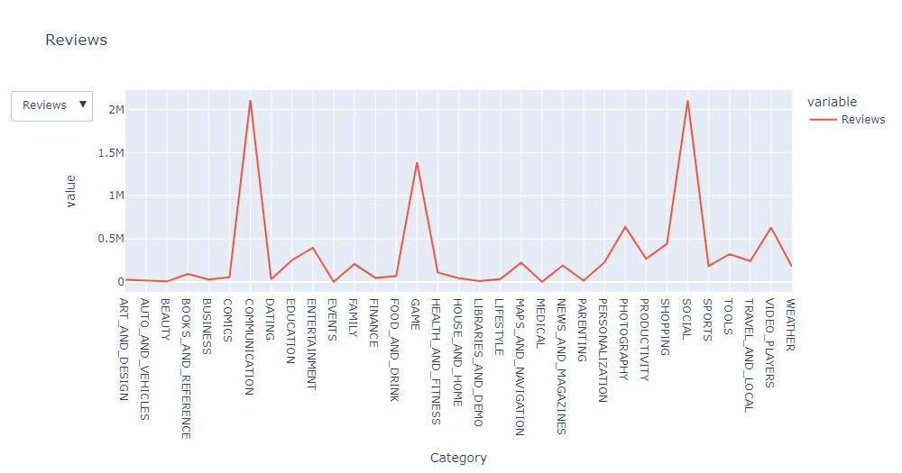
Check - 3
Notes:
As our hero "Installs" vs "Reviews" have a correlation value of 0.64, shows perfect and strong correlationfrom above line chart as both "installs" and "Reviews" follow the same pattern approximately.

Slide 20
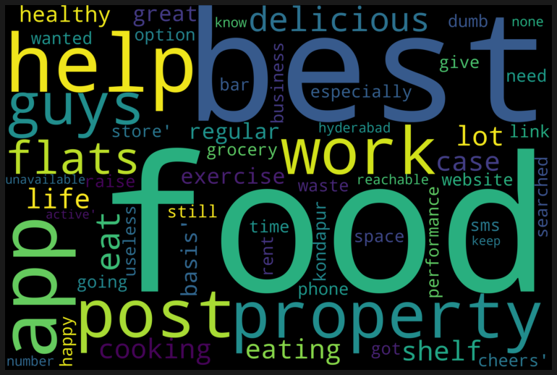
Observation - 6
Observation 6
Notes:
let's describe a poster/hashtag for our storyline/data, which helps the audience to see some repetitive words of our story.

Slide 21
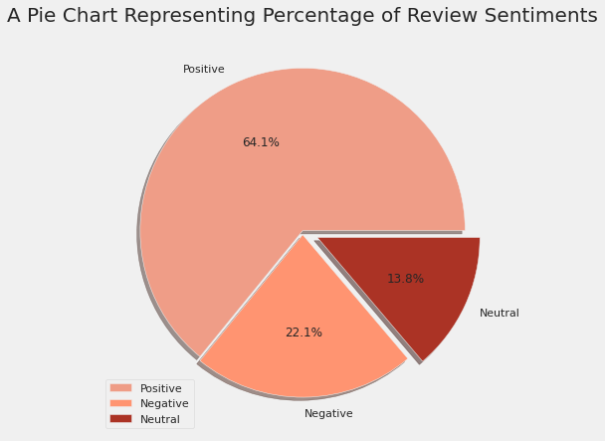
Observation - 7
Notes:
Before ending our story let me introduce the "Sentiment" of our story.
sentiments give us an idea about the emotions of the story whether it's positive,negative or neutral
As is clear from the pie charts there are 64.1 % of Positive sentiments, 22.1% of Negative sentiments, and 13.8% neutral sentiments.

Slide 22
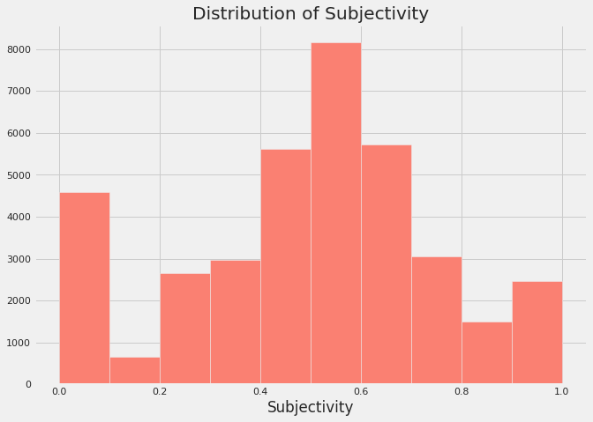
Observation - 8
Notes:
let's dive deep down into sentiments to see a more depth understanding of sentiment Polarity and Subjectivity.
It can be seen that the maximum number of sentiment subjectivity lies between 0.4 to 0.7. From this, we can conclude that the maximum number of the audience give reviews to the applications, according to their experience.

Slide 23
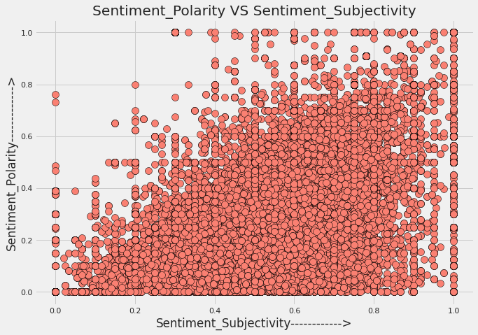
Observation - 9
Notes:
Does sentiments Polarity is proportional to sentiments subjectivity in our story?
From the above scatter plot it can be concluded that sentiment subjectivity is not always proportional to sentiment polarity but in maximum number of case, shows a proportional behavior, when variance is too high or low

Slide 24
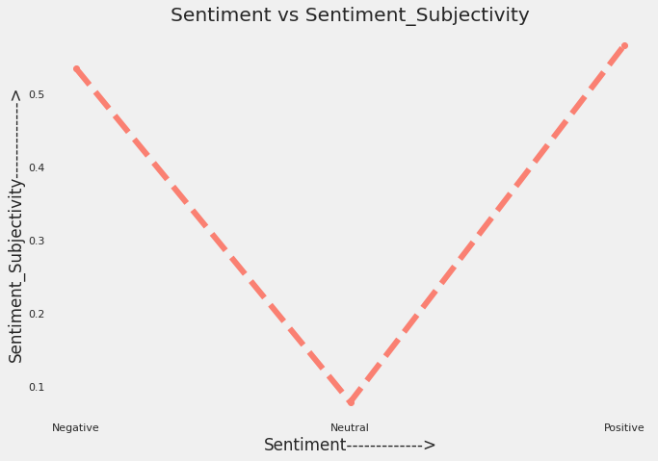
Observation - 10
Notes:
The above line has a Sentiment Subjectivity of 0.55 for Negative sentiments and Positive sentiments of 0.60.
Sentiment Subjectivity > 0.5(refers to that mostly it is public opinion and not a piece of factual information)
I know u got bored but Sentiment is also an important part of our story, we can't ignore it let's move further on to the interesting part of our story.

Slide 25
Conclusion
Notes:
Yayyy!!! This is the end of our story. Hope you enjoyed this journey. In this, we have seen
How every feature has a unique impact on the story
Why exploring data is important before starting to build ML models
How visualizations make anything interesting.
There's a hell lot of competition in Android market.
Thank You !!!!

Slide 26
Thank You!!!!
Notes:
Thank you very much for listening

